Slide 1
Early Years Foundation stage
In The Moment Planning – embracing individual learning for all pupils.

Slide 2


Slide 3
What does Ofsted say is the preferred teaching style?
https://www.youtube.com/watch?v=sWf6oHE9YqY

Slide 4
What does Ofsted say teaching is?
‘Teaching should not be taken to imply a ‘top down’ or formal way of working. It is a broad term which covers the many different ways in which adults help young children learn. It includes their interactions with children during planned and child-initiated play and activities: communicating and modelling language, showing, explaining, demonstrating, exploring ideas, encouraging, questioning, recalling, providing a narrative for what they are doing, facilitating and setting challenges. It takes account of the equipment they provide and the attention to the physical environment as well as the structure and routines of the day that establish expectations. Integral to teaching is how practitioners assess what children know, understand and can do as well as take account of their interests and dispositions to learning (characteristics of effective learning), and use this information to plan children’s next steps in learning and monitor their progress.’
Early years inspection handbook, Ofsted, June 2015; www.gov.uk/government/publications/early-years-inspection-handbook-from-september-2015.
Ofsted definition of teaching:
Ofsted does not have a preferred style or approach to teaching or play. Those working in schools and settings, rather than inspectors, are best placed to make the important decisions about how children learn. However, Ofsted does define the elements of early years practice that make up teaching so that there is a common ground and degree of transparency when making judgements about the quality of teaching.

Slide 5
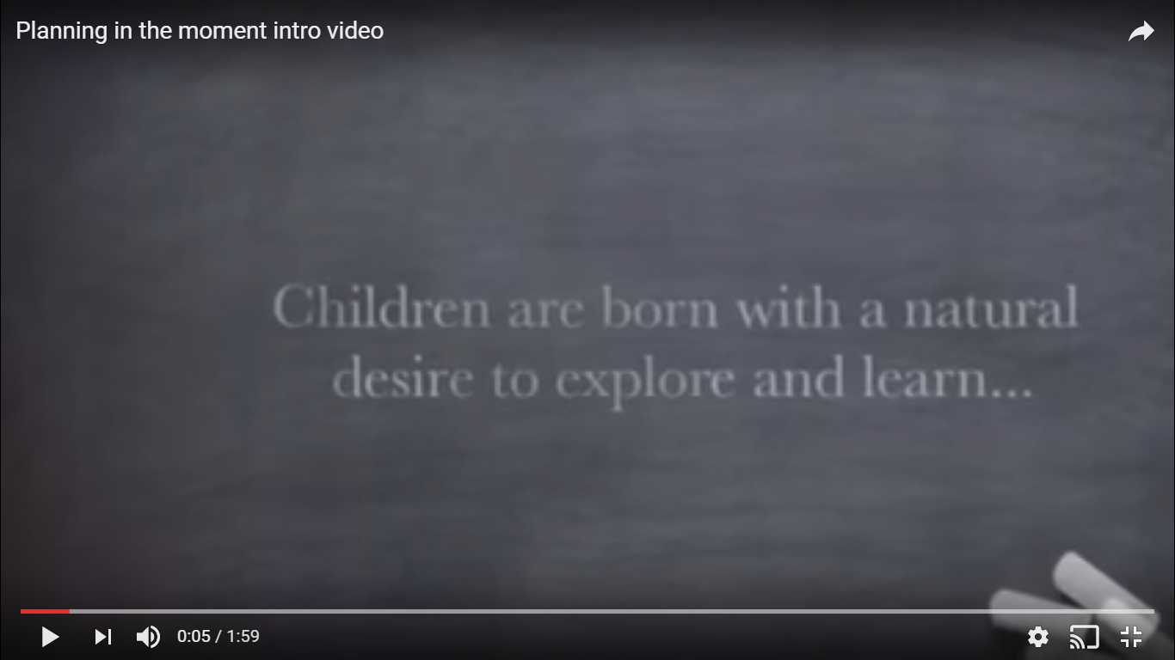
In The Moment
https://www.youtube.com/watch?v=IcjVPzLVpBI
https://Carter Hatch Infants & Anna Ephgrave

Slide 6
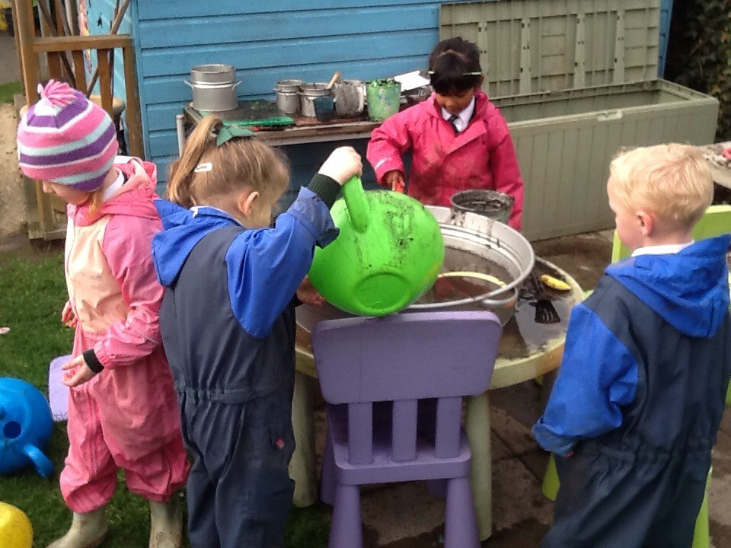
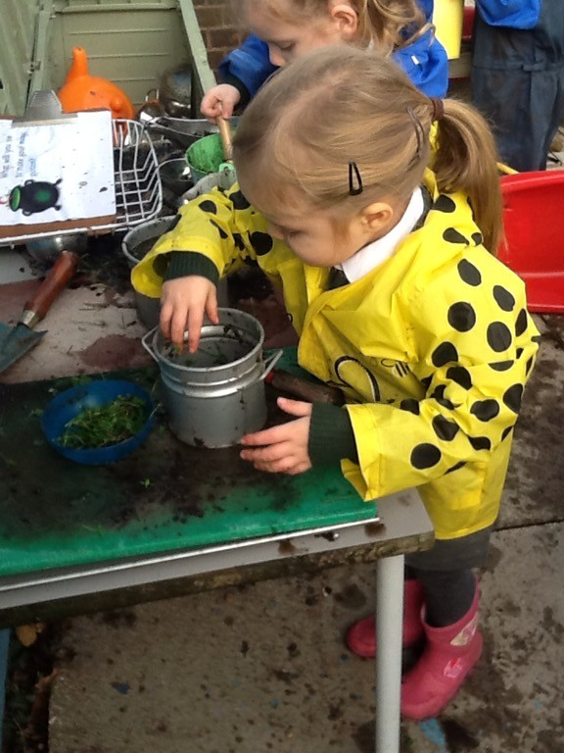
At the recent Early Years Excellence Conference , Professor Robert Winston stated that humans operate best when socialising and being entertained. How they communicate at an early age will determine how they develop as thinkers and whether or not they are resilient. Music plays a major part of brain development for language, training the brain to hear different tones, timbres as well as timing, rhythm plus memory skills.
Exploring the world around them will ignite their imagination and develop their curiosity. Sharing these experiences amongst peers they will begin to develop the social interactions that will prepare them to deal with conflict resolutions and to express their needs taking into consideration the feelings ot others. As experienced practitioners our role during these interactions is to identify whether or not our interactions will interfere or enhance the dialogue. Therefore we do spend a lot of time observing and then asking later what was being discussed .

Slide 7
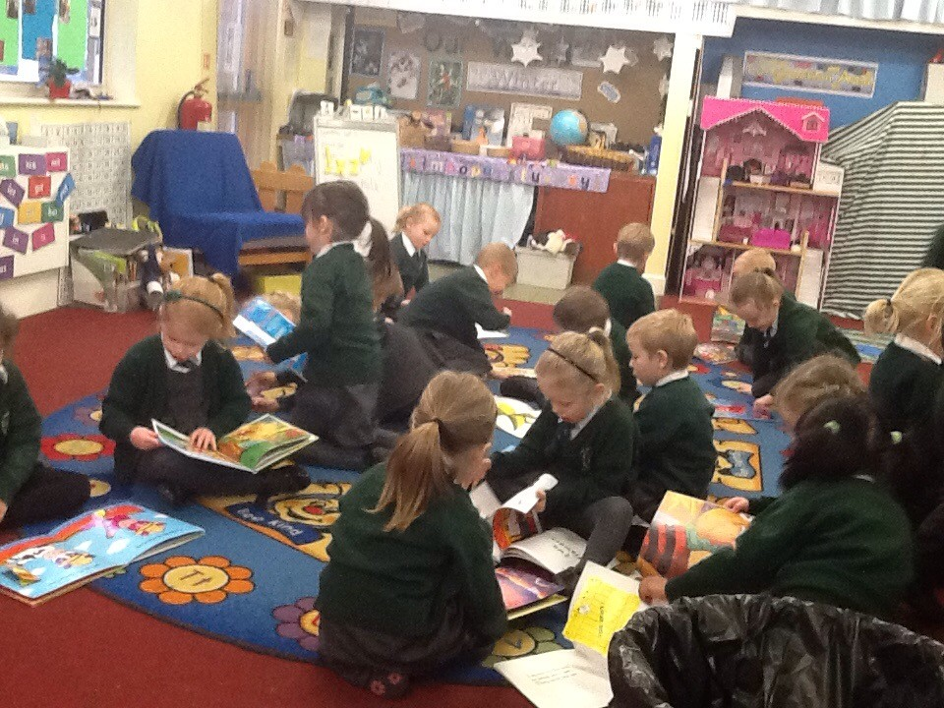
Our day usually starts with registration and then follows an engrossed session of deep engagement. Snack is available for the children to help themselves to at a table where they sit together in their chosen friendship groups. The children make their own selections and are supported by an adult to encourage and introduce conversation. We end the morning with a carpet session with phonics and handwriting, this is a planned session lasting 15 – 20 mins.
After lunch we deliver another adult let session focusing on number, again lasting 15 – 20 mins the children then engage in an afternoon of play and learning. They then complete the afternoon with a final carpet time when we finish with a story and a group discussion of what the children have achieved in the day. This provides an opportunity for us to prepare any resources that may need to be prepared for the following day.

Slide 8
How do we document progress?
Each child has an electronic learning journal, in this we record photos and videos of key learning moments – these are then assessed against the Early learning goals. The journals are shared with parents as they are created and they have the opportunity to add their comments. Parents can also add evidence of learning experiences from home too, family day trips or children extending their learning in the home environment. We also document the individual learning journey of each child having key children to observe each week. From these observations we identify next steps targets to use when we are integrating with the class to support learning and development.

